Slide 1
Cloud computing Module -1

Slide 2

Part -1 Introduction to cloud computing

Slide 3
Introduction
Computing is being transformed into a model consisting of services that are commoditized and delivered in a manner similar to utilities such as water, electricity, gas, and telephony. In such a model, users access services based on their requirements, regardless of where the services are hosted.
Cloud computing is a technological advancement that focuses on the way we design computing systems, develop applications, and leverage existing services for building software. It is based on the concept of dynamic provisioning, which is applied not only to services but also to compute capability, storage, networking, and information technology (IT) infrastructure in general.

Slide 4
Introduction
Cloud computing is the delivery of computing services—including servers, storage, databases, networking, software, analytics, and intelligence—over the Internet (“the cloud”) to offer faster innovation, flexible resources, and economies of scale.
Users
Cloud Providers
Mobile
Internet
Cloud
Amazon
Laptop
Microsoft
PC
Google
Tablet

Slide 5
Introduction
I don’t care where my servers are, who manages them, where my documents are stored, or where my applications are hosted. I just want them always available and access them from any device connected through Internet. And I am willing to pay for this service for as a long as I need it.
Web 2.0 technologies play a central role in making cloud computing an attractive opportunity for building computing systems. Service orientation allows cloud computing to deliver its capabilities with familiar abstractions, while virtualization confers on cloud computing the necessary degree of customization, control, and flexibility for building production and enterprise systems.

Slide 6
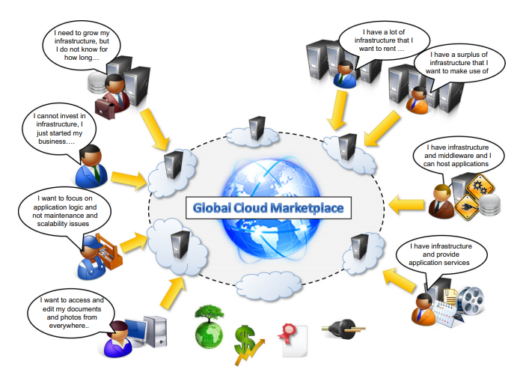
The vision of cloud computing

Slide 7
The vision of cloud computing
The long-term vision of cloud computing is that IT services are traded as utilities in an open market, without technological and legal barriers. In this cloud marketplace, cloud service providers and consumers, trading cloud services as utilities, play a central role.
Vision of cloud computing is that in the near future it will be possible to find the solution that matches the customer needs by simply entering our request in a global digital market that trades cloud computing services.

Slide 8
Defining a cloud
Definition given by Armbrust:
Cloud computing refers to both the applications delivered as services over the Internet and the hardware and system software in the datacenters that provide those services.
This definition describes cloud computing as a phenomenon touching on the entire stack: from the underlying hardware to the high-level software services and applications. It introduces the concept of everything as a service, mostly referred as XaaS, where the different components of a system—IT infrastructure, development platforms, databases, and so on—can be delivered, measured, and consequently priced as a service. The approach fostered by cloud computing is global.

Slide 9
Defining a cloud
Definition proposed by the U.S. National Institute of Standards and Technology (NIST):
Cloud computing is a model for enabling ubiquitous, convenient, on-demand network access to a shared pool of configurable computing resources (e.g., networks, servers, storage, applications, and services) that can be rapidly provisioned and released with minimal management effort or service provider interaction.

Slide 10
Defining a cloud
According to Reese
we can define three criteria to discriminate whether a service is delivered in the cloud computing style:
The service is accessible via a Web browser (nonproprietary) or a Web services application programming interface (API).
Zero capital expenditure is necessary to get started.
You pay only for what you use as you use it.

Slide 11
A closer look
Cloud computing is helping enterprises, governments, public and private institutions, and research organizations shape more effective and demand-driven computing systems. Access to, as well as integration of, cloud computing resources and systems is now as easy as performing a credit card transaction over the Internet.
Practical examples of such systems exist across all market segments:
Large enterprises can offload some of their activities to cloud-based systems. • Small enterprises and start-ups can afford to translate their ideas into business results more quickly, without excessive up-front costs.
System developers can concentrate on the business logic rather than dealing with the complexity of infrastructure management and scalability.
End users can have their documents accessible from everywhere and any device. Cloud computing does not only contribute with the opportunity of easily accessing IT services on demand, it also introduces a new way of thinking about IT services and resources: as utilities.

Slide 12
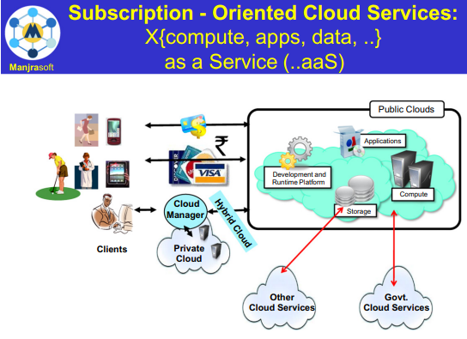
A bird’s-eye view of a cloud computing environment

Slide 13
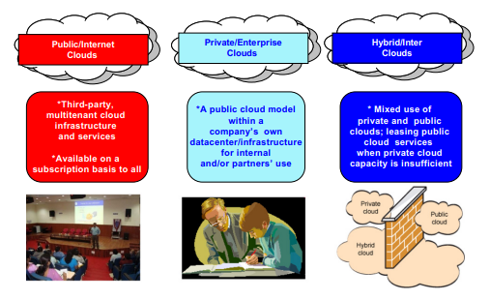
Cloud Deployment Models

Slide 14
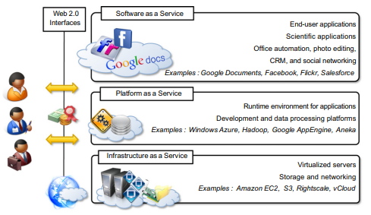
The cloud computing reference model

Slide 15
The cloud computing reference model
Web 2.0: These tools are internet tools that allow the user to go beyond just receiving information through the web. Web 2.0 can be defined as an attempt to explain and explore the business rules of that platform.
Web 2.0 are websites and applications that make use of user-generated content for end users. Web 2.0 is characterized by greater user interactivity and collaboration, more pervasive network connectivity and enhanced communication channels.
A fundamental characteristic of cloud computing is the capability to deliver, on demand, a variety of IT services that are quite diverse from each other. This variety creates different perceptions of what cloud computing is among users. Despite this lack of uniformity, it is possible to classify cloud computing services offerings into three major categories:
Infrastructure-as-a-Service (IaaS)
Platform-as-a-Service (PaaS)
Software-as-a-Service (SaaS).

Slide 16
The cloud computing reference model
The model organizes the wide range of cloud computing services into a layered view that walks the computing stack from bottom to top.
At the base of the stack, Infrastructure-as-a-Service solutions deliver infrastructure on demand in the form of virtual hardware, storage, and networking. Virtual hardware is utilized to provide compute on demand in the form of virtual machine instances. These are created at users’ request on the provider’s infrastructure, and users are given tools and interfaces to configure the software stack installed in the virtual machine. The pricing model is usually defined in terms of dollars per hour. Virtual storage is delivered in the form of raw disk space or object store. Virtual networking identifies the collection of services that manage the networking among virtual instances and their connectivity to the Internet or private networks.
Each layer provides a different service to users. IaaS solutions are sought by users who want to leverage cloud computing from building dynamically scalable computing systems requiring a specific software stack. IaaS services are therefore used to develop scalable Websites or for back- ground processing.

Slide 17
The cloud computing reference model
Platform-as-a-Service solutions are the next step in the stack. They deliver scalable and elastic runtime environments on demand and host the execution of applications. These services are backed by a core middleware platform that is responsible for creating the abstract environment where applications are deployed and executed. It is the responsibility of the service provider to provide scalability and to manage fault tolerance, while users are requested to focus on the logic of the application developed by leveraging the provider’s APIs and libraries. This approach increases the level of abstraction at which cloud computing is leveraged but also constrains the user in a more controlled environment.
PaaS solutions provide scalable programming platforms for developing applications and are more appropriate when new systems have to be developed.

Slide 18
The cloud computing reference model
At the top of the stack, Software-as-a-Service solutions provide applications and services on demand. Most of the common functionalities of desktop applications—such as office automation, document management, photo editing, and customer relationship management (CRM) software—are replicated on the provider’s infrastructure and made more scalable and accessible through a browser on demand. These applications are shared across multiple users whose interaction is isolated from the other users. The SaaS layer is also the area of social networking Websites, which leverage cloud-based infrastructures to sustain the load generated by their popularity.
SaaS solutions target mostly end users who want to benefit from the elastic scalability of the cloud without doing any software development, installation, configuration, and maintenance.

Slide 19
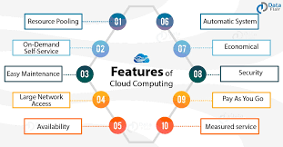
Characteristics and benefits

Slide 20
Characteristics and benefits
As per the Text Book:
Cloud computing has some interesting characteristics that bring benefits to both cloud service consumers (CSCs) and cloud service providers (CSPs).
These characteristics are:
No up-front commitments
On-demand self-services
Nice pricing
Simplified application acceleration and scalability
Efficient resource allocation
Energy efficiency
Seamless creation and use of third-party services

Slide 21
Characteristics and benefits
On-demand self-services: The Cloud computing services does not require any human administrators, user themselves are able to provision, monitor and manage computing resources as needed.
Broad network access: The Computing services are generally provided over standard networks and heterogeneous devices.
Rapid elasticity: The Computing services should have IT resources that are able to scale out and in quickly and on as needed basis. Whenever the user require services it is provided to him and it is scale out as soon as its requirement gets over.
Resource pooling: The IT resource (e.g., networks, servers, storage, applications, and services) present are shared across multiple applications and occupant in an uncommitted manner. Multiple clients are provided service from a same physical resource.
Measured service: The resource utilization is tracked for each application and occupant, it will provide both the user and the resource provider with an account of what has been used. This is done for various reasons like monitoring billing and effective use of resource.
Multi-tenancy: Cloud computing providers can support multiple tenants (users or organizations) on a single set of shared resources.

Slide 22
Characteristics and benefits
Virtualization: Cloud computing providers use virtualization technology to abstract underlying hardware resources and present them as logical resources to users.
Resilient computing: Cloud computing services are typically designed with redundancy and fault tolerance in mind, which ensures high availability and reliability.
Flexible pricing models: Cloud providers offer a variety of pricing models, including pay-per-use, subscription-based, and spot pricing, allowing users to choose the option that best suits their needs.
Security: Cloud providers invest heavily in security measures to protect their users’ data and ensure the privacy of sensitive information.
Automation: Cloud computing services are often highly automated, allowing users to deploy and manage resources with minimal manual intervention.
Sustainability: Cloud providers are increasingly focused on sustainable practices, such as energy-efficient data centers and the use of renewable energy sources, to reduce their environmental impact.

Slide 23
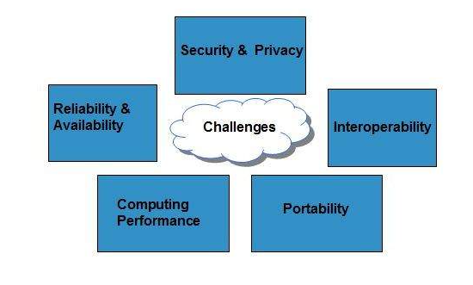
Challenges ahead

Slide 24
Challenges ahead
Challenges’ concerning the dynamic provisioning of cloud computing services and resources arises. For example, in the Infrastructure-as-a-Service domain, how many resources need to be provisioned, and for how long should they be used, in order to maximize the benefit?
Technical challenges also arise for cloud service providers for the management of large computing infrastructures and the use of virtualization technologies on top of them.
Security in terms of confidentiality, secrecy, and protection of data in a cloud environment is another important challenge. Organizations do not own the infrastructure they use to process data and store information. This condition poses challenges for confidential data, which organizations cannot afford to reveal.
Legal issues may also arise. These are specifically tied to the ubiquitous nature of cloud computing, which spreads computing infrastructure across diverse geographical locations. Different legislation about privacy in different countries may potentially create disputes as to the rights that third parties (including government agencies) have to your data.

Slide 25
Challenges ahead
Security and Privacy: Security and Privacy of information is the biggest challenge to cloud computing. Security and privacy issues can be overcome by employing encryption, security hardware and security applications.
Portability: This is another challenge to cloud computing that applications should easily be migrated from one cloud provider to another. There must not be vendor lock-in. However, it is not yet made possible because each of the cloud provider uses different standard languages for their platforms.
Interoperability: It means the application on one platform should be able to incorporate services from the other platforms. It is made possible via web services, but developing such web services is very complex.
Computing Performance: Data intensive applications on cloud requires high network bandwidth, which results in high cost. Low bandwidth does not meet the desired computing performance of cloud application.
Reliability and Availability: It is necessary for cloud systems to be reliable and robust because most of the businesses are now becoming dependent on services provided by third-party.

Slide 26
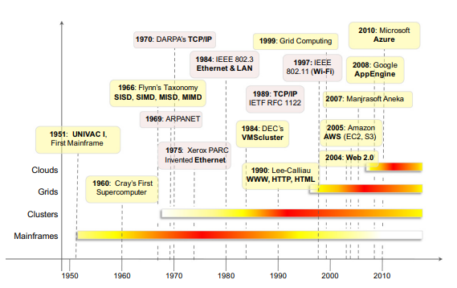
Historical developments

Slide 27
Distributed systems
A distributed system is a collection of independent computers that appears to its users as a single coherent system.
Distributed systems often exhibit other properties such as heterogeneity, openness, scalability, transparency, concurrency, continuous availability, and independent failures. To some extent these also characterize clouds, especially in the context of scalability, concurrency, and continuous availability.
Three major milestones have led to cloud computing: mainframe computing, cluster computing, and grid computing.

Slide 28
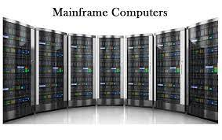
Mainframes
These were the first examples of large computational facilities leveraging multiple processing units. Mainframes were powerful, highly reliable computers specialized for large data movement and massive input/output (I/O) operations.
They were mostly used by large organizations for bulk data processing tasks such as online transactions, enterprise resource planning, and other operations involving the processing of significant amounts of data.
Even though mainframes cannot be considered distributed systems, they offered large computational power by using multiple processors, which were presented as a single entity to users.
One of the most attractive features of mainframes was the ability to be highly reliable computers that were “always on” and capable of tolerating failures transparently. No system shutdown was required to replace failed components, and the system could work without interruption. Batch processing was the main application of mainframes.
Now their popularity and deployments have reduced, but evolved versions of such systems are still in use for transaction processing (such as online banking, airline ticket booking, supermarket and telcos, and government services).

Slide 29
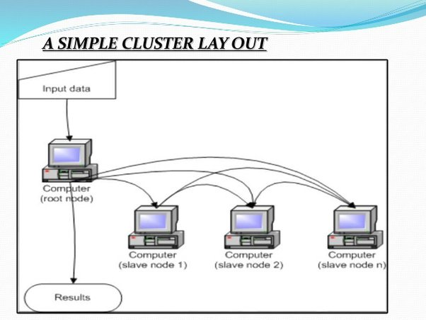
Clusters
Cluster computing started as a low-cost alternative to the use of mainframes and supercomputers. The technology advancement that created faster and more powerful mainframes and supercomputers eventually generated an increased availability of cheap commodity machines as a side effect.
These machines could then be connected by a high-bandwidth network and controlled by specific software tools that manage them as a single system. Starting in the 1980s, clusters become the standard technology for parallel and high-performance computing.
Built by commodity machines, they were cheaper than mainframes and made high-performance computing available to a large number of groups, including universities and small research labs.

Slide 30
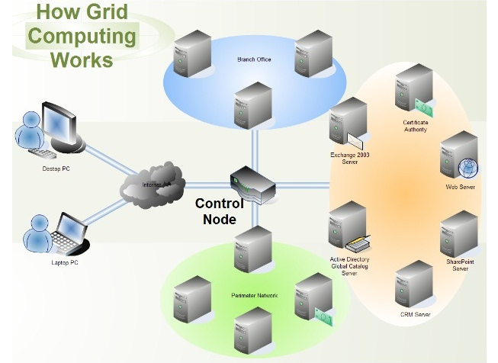
Grid computing

Slide 31
Grid computing
Several developments made possible the diffusion of computing grids:
(a) clusters became quite common resources;
(b) they were often underutilized;
(c) new problems were requiring computational power that went beyond the capability of single clusters; and
(d) the improvements in networking and the diffusion of the Internet made possible long-distance, high-bandwidth connectivity.
All these elements led to the development of grids, which now serve a multitude of users across the world.

Slide 32
Cloud computing
Cloud computing is often considered the successor of grid computing. In reality, it embodies aspects of all these three major technologies. Computing clouds are deployed in large datacenters hosted by a single organization that provides services to others. Clouds are characterized by the fact of having virtually infinite capacity, being tolerant to failures, and being always on, as in the case of mainframes.
In many cases, the computing nodes that form the infrastructure of computing clouds are commodity machines, as in the case of clusters. The services made available by a cloud vendor are consumed on a pay-per-use basis, and clouds fully implement the utility vision introduced by grid computing.

Slide 33
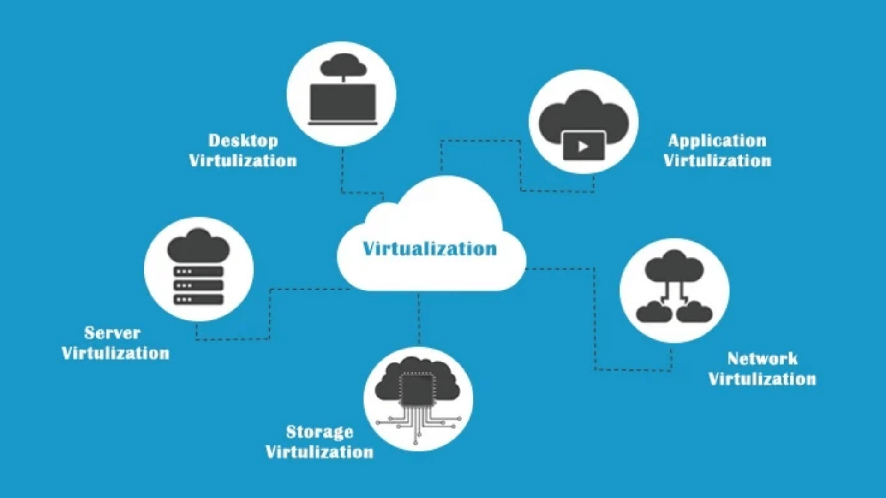
Virtualization
Virtualization is technology that you can use to create virtual representations of servers, storage, networks, and other physical machines. Virtual software mimics the functions of physical hardware to run multiple virtual machines simultaneously on a single physical machine.

Slide 34
Virtualization
Virtualization is the creation of a virtual (rather than actual) version of something, such as an operating system, a server, a storage device or network resources
It is the process of converting a physical IT resource into a virtual IT resource
It encompasses a collection of solutions allowing the abstraction of some of the fundamental elements for computing, such as hardware, runtime environments, storage, and networking
Virtualization is essentially a technology that allows creation of different computing environments.
These environments are called virtual because they simulate the interface that is expected by a guest.

Slide 35
Virtualization
Hardware virtualization is a technology allows simulating / Emulation the h/w interface expected by an operating system
Hardware virtualization allows the coexistence of different software stacks on top of the same hardware.
These stacks are contained inside virtual machine instances, which operate in complete isolation from each other.
High-performance servers can host several virtual machine instances, thus creating the opportunity to have a customized software stack on demand.
This is the base technology that enables cloud computing solutions to deliver virtual servers on demand, such as Amazon EC2, RightScale, Vmware vCloud and others together with hardware virtualization, storage and network virtualization.

Slide 36
Virtualization
Virtualization technologies are also used to replicate runtime environments for programs
Applications in the case of process virtual machines instead of being executed by the operating system are run by a specific program called a virtual machine.
Process virtual machines offer a higher level of abstraction with respect to hardware virtualization, since the guest is only constituted by an application rather than a complete software stack
Eg: Google App Engine and Windows Azure

Slide 37
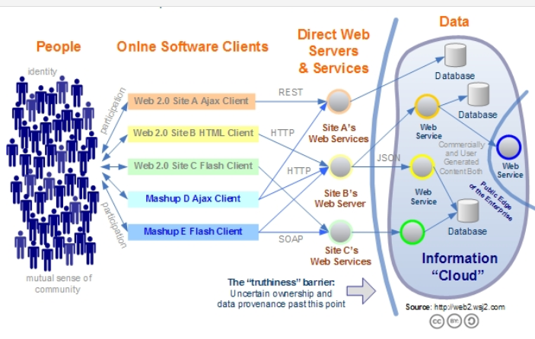
Web 2.0

Slide 38
Web 2.0
The Web is the primary interface through which cloud computing delivers its services.
At present, the Web encompasses a set of technologies and services that facilitate interactive information sharing, collaboration, user-centered design, and application composition. This evolution has transformed the Web into a rich platform for application development and is known as Web 2.0.
Web 2.0 brings interactivity and flexibility into Web pages, providing enhanced user experience by gaining Web-based access to all the functions that are normally found in desktop applications.
These capabilities are obtained by integrating a collection of standards and technologies such as XML, Asynchronous JavaScript and XML (AJAX), Web Services, and others.

Slide 39
Web 2.0
Web 2.0 brings interactivity and flexibility into Web pages, providing enhanced user experience by gaining Web-based access to all the functions that are normally found in desktop applications. These capabilities are obtained by integrating a collection of standards and technologies such as XML, Asynchronous JavaScript and XML (AJAX), Web Services, and others. These technologies allow us to build applications leveraging the contribution of users, who now become providers of content
Examples of Web 2.0 applications are Google Documents, Google Maps, Flickr, Facebook, Twitter, YouTube, de.li.cious, Blogger, and Wikipedia. In particular, social networking Websites take the biggest advantage of Web 2.0.

Slide 40
Service-oriented computing
Adopts the concept of services as the main building blocks of application and system development.
Service-oriented computing (SOC) supports the development of rapid, low-cost, flexible, interoperable, and evolvable applications and systems  A service is an abstraction representing a self-describing and platform-agnostic component that can perform any function—anything from a simple function to a complex business process.
A service is supposed to be loosely coupled, reusable, programming language independent, and location transparent.

Slide 41
Service-oriented computing
Service-oriented computing introduces two concepts, fundamental to cloud computing: quality of service (QoS) and Software-as-a-Service (SaaS).
QoS identifies a set of functional and nonfunctional attributes that can be used to evaluate the behavior of a service from different perspectives- response time, or security attributes, transactional integrity, reliability, scalability, and availability.
Saas is new delivery model for applications. The term has been inherited from the world of application service providers

Slide 42
UTILITY-ORIENTED COMPUTING
Utility computing is a vision of computing that defines a service-provisioning model for compute services  The idea of providing computing as a utility like natural gas, water, power, and telephone connection
Early days mainframe providers offered mainframe power to organizations such as banks and government agencies throughout their datacenters.
service-oriented architectures(SOAs) introduced the idea of leveraging external services for performing a specific task within a software system
Cluster computing and Computing grids brought the concept of utility computing to a new level: market orientation

Slide 43
BUILDING CLOUD COMPUTING ENVIRONMENTS
The creation of cloud computing environments encompasses both the development of applications and systems that leverage cloud computing solutions and the creation of frameworks, platforms, and infrastructures delivering cloud services.
APPLICATION DEVELOPMENT
Applications that leverage cloud computing benefit from its capability to dynamically scale on demand. One class of applications that takes the biggest advantage of this feature is that of Web applications.
With the diffusion of Web 2.0 technologies, the Web has become a platform for developing rich and complex applications, including enterprise applications

Slide 44
BUILDING CLOUD COMPUTING ENVIRONMENTS
Another class of applications that can potentially gain considerable advantage are resource-intensive applications. These can be either data intensive or compute-intensive applications.
In both cases, considerable amounts of resources are required to complete execution in a reasonable timeframe.
Cloud computing provides a solution for on-demand and dynamic scaling across the entire stack of computing that can be achieved by
(a) providing methods for renting h/w resources
(b) offering runtime environments
(c) providing application services

Slide 45
INFRASTRUCTURE AND SYSTEM DEVELOPMENT
Distributed computing, virtualization, service orientation, and Web 2.0 form the core technologies enabling the provisioning of cloud services from anywhere on the globe.
Developing applications, systems that leverage the cloud requires knowledge of all these technologies. Moreover, new challenges need to be addressed from design/ development points.
Distributed computing is a foundational model for cloud computing because cloud systems are distributed systems
Virtualization is a core feature of the infrastructure especially in the management of virtual environments, (abstractions runtime env).
XaaS—Everything-as-a-Service—that clearly underlines the central role of service orientation
Web 2.0 technologies constitute the interface through which cloud computing services are delivered, managed, and provisioned

Slide 46
COMPUTING PLATFORMS AND TECHNOLOGIES
Amazon web services (AWS)
Google AppEngine
Microsoft Azure
Hadoop
Force.com and Salesforce.com
Manjrasoft Aneka

Slide 47
AMAZON WEB SERVICES (AWS)
AWS offers comprehensive cloud IaaS services ranging from virtual compute, storage, and networking to complete computing stacks.
AWS is mostly known for its compute and storage-on demand services, namely Elastic Compute Cloud (EC2) and Simple Storage Service (S3).
EC2 provides users with customizable virtual hardware that can be used as the base infrastructure for deploying computing systems on the cloud.
EC2 also provides the capability to save a specific running instance as an image, thus allowing users to create their own templates & store into S3 (persistent storage on demand).
S3 is organized into buckets; these are containers of objects that are stored in binary form and can be enriched with attributes. Users can store objects of any size, are accessible .

Slide 48
GOOGLE APPENGINE
Google AppEngine is a scalable runtime environment mostly devoted to executing Web applications.
Google infrastructure enable dynamical scaling.
AppEngine provides both a secure execution environment and a collection of services that simplify the development of scalable and high-performance Web applications.
Developers can build and test applications on their own machines using the AppEngine SDK.
Once development is complete, developers can easily migrate their application to AppEngine
Java, PHP, Node.js, Python, C#, .Net, Ruby etc.

Slide 49
MICROSOFT AZURE
Microsoft Azure is a cloud operating system and a platform for developing applications in the cloud.
Applications are organized around the concept of roles: Web role, worker role, and virtual machine role.
The Web role is designed to host a Web application,
worker role is a more generic container of applications and can be used to perform workload processing
virtual machine role provides a virtual environment in which the computing stack can be fully customized, including the operating systems.

Slide 50
HADOOP
Apache Hadoop is an open-source framework that is suited for processing large data sets on commodity hardware.
Hadoop is an implementation of MapReduce, an application programming model developed by Google, which provides two fundamental operations for data processing: map and reduce
The former transforms and synthesizes the input data provided by the user; the latter aggregates the output obtained by the map operations.
Hadoop provides the runtime environment, and developers need only provide the input data and specify the map and reduce functions that need to be executed.

Slide 51
FORCE.COM AND SALESFORCE.COM
Force.com is a cloud computing platform for developing social enterprise applications.
The platform is the basis for SalesForce.com, a Software-as-a-Service solution for customer relationship management.
Force.com allows developers to create applications by composing ready-to-use blocks; a complete set of components supporting all the activities of an enterprise are available.
The platform provides complete support for developing applications, from the design of the data layout to the definition of business rules and workflows and the definition of the user interface.

Slide 52
Manjrasoft Aneka
Manjrasoft Aneka is a cloud application platform for rapid creation of scalable applications and their deployment on various types of clouds in a seamless and elastic manner.
It supports a collection of programming abstractions for developing applications and a distributed runtime environment that can be deployed on heterogeneous hardware (clusters, networked desktop computers, and cloud resources).
Developers can choose different abstractions to design their application: tasks, distributed threads, and map-reduce.
These applications are then executed on the distributed service-oriented runtime environment, which can dynamically integrate additional resource on demand

Slide 53
Part -2 VIRTUALIZATION

Slide 54
VIRTUALIZATION TECHNOLOGIES
Virtualization allows the creation of a secure, customizable, and isolated execution environment (abstract env.) for running applications, even if they are untrusted, without affecting other user’s applications and the reasons for it’s popularity are;
Increased performance and computing capacity : high-end side of the PC market, supercomputers can provide immense compute power for hundreds or thousands of virtual machines
Underutilized hardware and software resources : Increased performance and computing capacity .The effect of limited or sporadic use of resources
Lack of space : most cases enterprises cannot afford to build another data center to accommodate additional resource capacity
Greening initiatives.
Rise of administrative costs

Slide 55
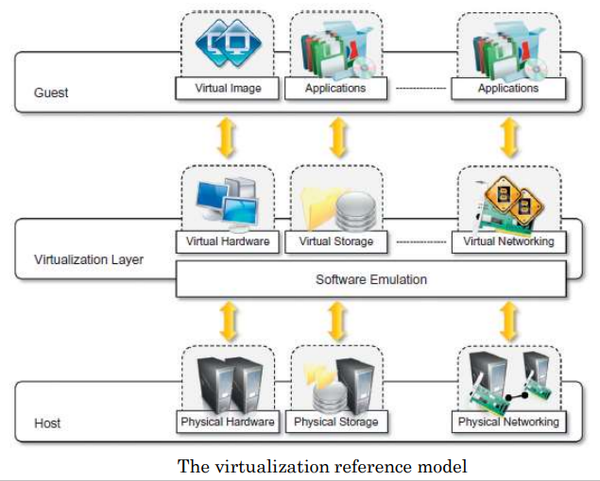
CHARACTERISTICS OF VIRTUALIZED ENVIRONMENTS

Slide 56
CHARACTERISTICS OF VIRTUALIZED ENVIRONMENTS
Virtualization is a broad concept that refers to the creation of a virtual version of something, whether hardware, a software environment, storage, or a network
Three major components: guest, host, and virtualization layer
The guest represents the system component that interacts with the virtualization layer
The host represents the original environment where the guest is supposed to be managed.
The virtualization layer is responsible for recreating the same or a different environment where the guest will operate

Slide 57
CHARACTERISTICS VIRTUALIZED ENVIRONMENTS
Increased security
Managed execution
Portability

Slide 58
Increased security
The virtual machine represents an emulated environment in which the guest is executed.
All the operations of the guest are generally performed against the virtual machine, which then translates and applies them to the host.
This level of indirection allows the virtual machine manager to control and filter the activity of the guest, thus preventing some harmful operations from being performed.
For example, applets downloaded from the Internet run in a sandboxed 3 version of the Java Virtual Machine (JVM), which provides them with limited access to the hosting operating system resources.
Both the JVM and the .NET runtime provide extensive security policies for customizing the execution environment of applications.

Slide 59
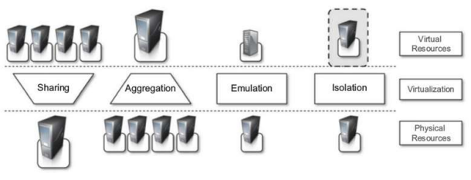
Managed execution

Slide 60
Managed execution
Functions enabled by Managed Execution of virtualization environment - sharing, aggregation, emulation, and isolation
Sharing:
Virtualization allows the creation of a separate computing environments within the same host.
fully exploit the capabilities otherwise it is underutilized.
reduce the number of active servers and limit power consumption.
Aggregation:
opposite process of sharing physical resource among several guests
A group of separate hosts can be tied together and represented to guests as a single virtual host.

Slide 61
Managed execution
Emulation:
Emulation is the process of imitating a hardware/software program/platform on another program or platform. This makes it possible to run programs on systems not designed for them
A completely different environment with respect to the host can be emulated, thus allowing the execution of guest programs requiring specific characteristics that are not present in the physical host
Isolation:
Virtualization allows providing guests—whether they are operating systems, applications, or other entities—with a completely separate environment, in which they are executed.
The guest program performs its activity by interacting with an abstraction layer, which provides access to the underlying resources

Slide 62
PORTABILITY
In hardware virtualization solution, the guest is packaged into a virtual image that, in most cases, can be safely moved and executed on top of different virtual machines.
In programming-level virtualization, as implemented by the JVM or the .NET runtime, the binary code representing application components (jars or assemblies) can be run without any recompilation on any implementation of the corresponding virtual machine
Run application on different platforms with no changes.

Slide 63
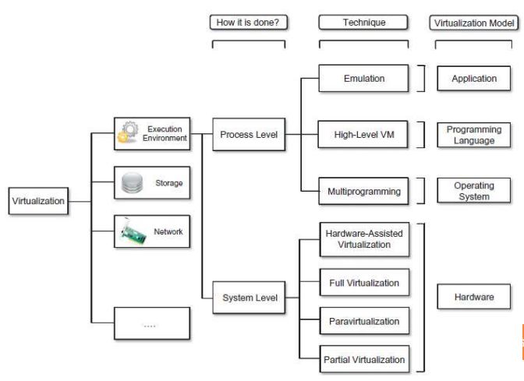
TAXONOMY OF VIRTUALIZATION TECHNIQUES

Slide 64
TAXONOMY OF VIRTUALIZATION TECHNIQUES
The first classification discriminates against the service or entity that is being emulated.
Two major categories by considering the type of host they require.
Process-level techniques are implemented on top of an existing operating system which has full control of the hardware
System-level techniques are implemented directly on hardware and do not require or require a minimum of support from an existing operating system.
Within these two categories we can list various techniques that offer the guest a different type of virtual computation environment:
bare hardware
operating system resources
low-level programming language
application libraries

Slide 65
EXECUTION VIRTUALIZATION
Machine reference model
Hardware-level virtualization
Hypervisors
Hardware virtualization techniques
Operating system-level virtualization
Programming language-level virtualization
Application-level virtualization

Slide 66
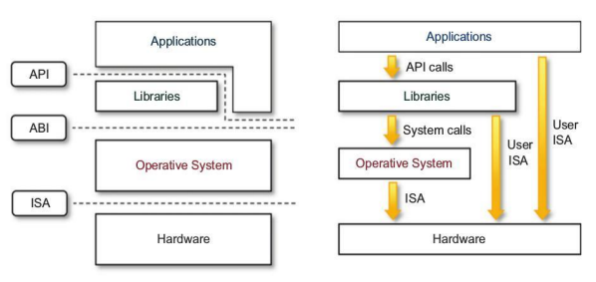
Machine reference model

Slide 67
Machine reference model
Virtualizing an execution environment at different levels of the computing stack requires a reference model that defines the interfaces between the levels of abstractions, which hide implementation details
hardware is expressed in terms of the Instruction Set Architecture (ISA), which defines the instruction set for the processor registers, memory, and interrupt management.
ISA is the interface between hardware and software, and it is important to the operating system(OS) developer(System ISA) and developers of applications that directly manage the underlying hardware (User ISA).
The application binary interface(ABI) separates the operating system layer from the applications and libraries, which are managed by the OS.

Slide 68
Machine reference model
ABI covers details such as low-level data types, alignment, and call conventions and defines a format for executable programs. System calls are defined at this level
The highest level of abstraction is represented by the application programming interface (API), which interfaces applications to libraries and/or the underlying operating system
The instruction set exposed by the hardware has been divided into different security classes
privileged instructions
nonprivileged instruction

Slide 69
Machine reference model
Nonprivileged instructions are those instructions that can be used without interfering with other tasks because they do not access shared resources.
Ex: all the floating, fixed-point, and arithmetic instructions
Privileged instructions are those that are executed under specific restrictions and are mostly used for sensitive operations, which expose (behavior-sensitive) or modify (control-sensitive) the privileged state.
Ex: behavior-sensitive instructions are those that operate on the I/O, whereas control-sensitive instructions alter the state of the CPU registers

Slide 70
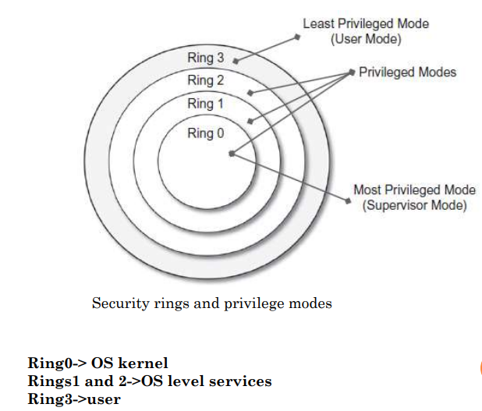
Machine reference model

Slide 71
Machine reference model
supervisor mode(master mode or kernel mode ): execution mode in which all the instructions (privileged and nonprivileged) can be executed without any restriction
User mode: there are restrictions to control the machine-level resources
If code running in user mode invokes the privileged instructions, hardware interrupts occur and trap the potentially harmful execution of the instruction.
Role of the hypervisor: hypervisor(VMM) runs above the supervisor mode

Slide 72
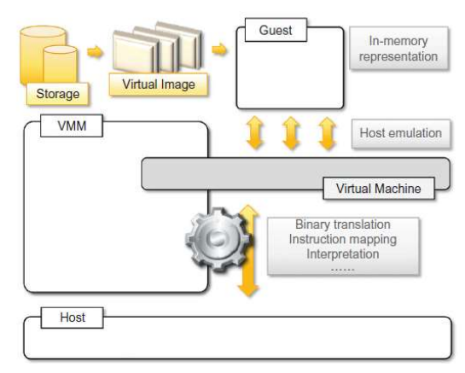
HARDWARE-LEVEL VIRTUALIZATION

Slide 73
HARDWARE-LEVEL VIRTUALIZATION
Hardware-level virtualization is a virtualization technique that provides an abstract execution environment in terms of computer hardware on top of which a guest operating system can be run.
In this model,
The guest is represented by the operating system
The host by the physical computer hardware
The virtual machine by its emulation
The virtual machine manager by the hypervisor
Hardware-level virtualization is also called system virtualization, since it provides ISA to virtual machines, which is the representation of the hardware interface of a system

Slide 74
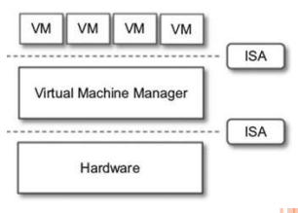
Hypervisor
A fundamental element of hardware virtualization is the hypervisor, or virtual machine manager (VMM). It recreates a hardware environment in which guest operating systems are installed.
There are two major types of hypervisor:
Type I and Type II
Type I hypervisors run directly on top of the hardware. Therefore, they take the place of the operating systems and interact directly with the ISA interface exposed by the underlying hardware, and they emulate this interface in order to allow the management of guest operating systems.
This type of hypervisor is also called a native virtual machine since it runs natively on hardware.

Slide 75
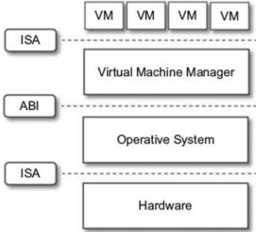
Hypervisor
Type II hypervisors require the support of an operating system to provide virtualization services.
This means that they are programs managed by the operating system, which interact with it through the ABI and emulate the ISA of virtual hardware for guest operating systems.
This type of hypervisor is also called a hosted virtual machine since it is hosted within an operating system

Slide 76
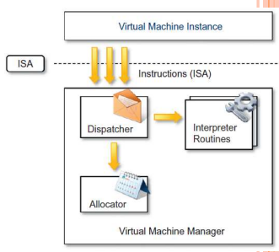
Hypervisor reference architecture
Three main modules, dispatcher, allocator, and interpreter, coordinate their activity in order to emulate the underlying hardware
The dispatcher -the entry point of the monitor and reroutes the instructions issued by the VM instance to one of the two other modules.
The allocator is responsible for deciding the system resources to be provided to the VM
The interpreter module consists of interpreter routines. These are executed whenever a virtual machine executes a privileged instruction: a trap is triggered and the corresponding routine is executed.

Slide 77
Hypervisor
According to Goldberg and Popek[1974] -virtual machine manager - Three properties have to be satisfied:
Equivalence: A guest running under the control of a virtual machine manager should exhibit the same behavior as when it is executed directly on the physical host.
Resource control: The virtual machine manager should be in complete control of virtualized resources.
Efficiency: A statistically dominant fraction of the machine instructions should be executed without intervention from the virtual machine manager.
Popek and Goldberg provided a classification of the instruction set and proposed three theorems that define the properties that hardware instructions need to satisfy support virtualization.

Slide 78
Hypervisor
THEOREM 3.1 : For any conventional third-generation computer, a VMM may be constructed if the set of sensitive instructions for that computer is a subset of the set of privileged instructions.
THEOREM3.2: A conventional third-generation computer is recursively virtualizable if:
It is virtualizable and
A VMM without any timing dependencies can be constructed for it.
THEOREM 3.3: A hybrid VMM may be constructed for any conventional third-generation machine in which the set of user-sensitive instructions are a subset of the set of privileged instructions.

Slide 79
Hardware virtualization techniques
1. Hardware-assisted virtualization
A scenario in which the hardware provides architectural support for building a virtual machine manager able to run a guest operating system in complete isolation.
Eg: Extensions to the x86-64 bit architecture introduced with Intel VT and AMD V
Software emulation of x86 hardware was significantly costly from the performance point of view
Kernel-based Virtual Machine (KVM), VirtualBox, Xen, VMware, Hyper-V, Sun xVM, Parallels, and others

Slide 80
Hardware virtualization techniques
2. Full Virtualization
Full virtualization refers to the ability to run a program, most likely an operating system, directly on top of a virtual machine and without any modification, as though it were run on the raw hardware.
To make this possible, virtual machine managers are required to provide a complete emulation of the entire underlying hardware.
The principal advantage of full virtualization is complete isolation, which leads to enhanced security, ease of emulation of different architectures, and coexistence of different systems on the same platform.
Ex: Kernel-based Virtual Machine (KVM), VirtualBox, VMware

Slide 81
3. Paravirtualization
Hardware virtualization techniques
This is a not-transparent virtualization solution that allows implementing thin virtual machine managers.
Paravirtualization techniques expose a software interface to the virtual machine that is slightly modified from the host and, as a consequence, guests need to be modified.
guest OS is recompiled prior to installation inside a virtual machine
The aim of paravirtualization is to provide the capability to demand the execution of performance critical operations directly on the host, thus preventing performance losses that would otherwise be experienced in managed execution.
Example: Xen

Slide 82
4. Partial virtualization
Hardware virtualization techniques
Partial virtualization provides a partial emulation of the underlying hardware, thus not allowing the complete execution of the guest operating system in complete isolation.
Partial virtualization allows many applications to run transparently, but not all the features of the operating system can be supported.
An example of partial virtualization is address space virtualization used in time-sharing systems; this allows multiple applications and users to run concurrently in a separate memory space, but they still share the same hardware resources (disk, processor, and network).
Ex IBM M44/44x

Slide 83
OPERATING SYSTEM-LEVEL VIRTUALIZATION
Operating system-level virtualization offers the opportunity to create different and separated execution environments for applications that are managed concurrently.
There is no virtual machine manager or hypervisor, and the virtualization is done within a single operating system, where the OS kernel allows for multiple isolated user space instances.
The kernel is also responsible for sharing the system resources among instances and for limiting the impact of instances on each other
Examples: FreeBSD Jails, IBM Logical Partition (LPAR), SolarisZones and Containers, Parallels Virtuozzo Containers, OpenVZ, iCore Virtual Accounts, Free Virtual Private Server (FreeVPS).

Slide 84
PROGRAMMING LANGUAGE-LEVEL VIRTUALIZATION
Programming language-level virtualization is mostly used to achieve ease of deployment of applications, managed execution, and portability across different platforms and operating systems.
It consists of a virtual machine executing the byte code of a program, which is the result of the compilation process.
Compilers implemented and used this technology to produce a binary format representing the machine code for an abstract architecture.
JVM of Java, CLI of .Net Environment

Slide 85
APPLICATION-LEVEL VIRTUALIZATION
Application-level virtualization is a technique allowing applications to be run in runtime environments that do not natively support all the features required by such applications.
Emulation is used to execute program binaries compiled for different hardware architectures.
strategies can be implemented:
Interpretation: In this technique every source instruction is interpreted by an emulator for executing native ISA instructions, leading to poor performance. Interpretation has a minimal startup cost but a huge overhead, since each instruction is emulated.
Binary translation: In this technique every source instruction is converted to native instructions with equivalent functions. After a block of instructions is translated, it is cached and reused. Binary translation has a large initial overhead cost, but over time it is subject to better performance, since previously translated instruction blocks are directly executed

Slide 86
OTHER TYPES OF VIRTUALIZATION
Storage virtualization: Storage virtualization is a system administration practice that allows decoupling the physical organization of the hardware from its logical representation.
Network virtualization: Network virtualization combines hardware appliances and specific software for the creation and management of a virtual network. Network virtualization can aggregate different physical networks into a single logical network (external network virtualization) or provide network like functionality to an operating system partition (internal network virtualization
Desktop virtualization abstracts the desktop environment available on a personal computer in order to provide access to it using a client/server approach.
It makes accessible a different system as it was natively installed on the host, but this system is remotely stored on a different host & accessed through a network connection.
It addresses the problem of making the same desktop environment accessible from everywhere. Application server virtualization
Application server virtualization abstracts a collection of application servers that provide the same services as a single virtual application server by using load-balancing strategies and providing a high-availability infrastructure for the services hosted in the application server.

Slide 87
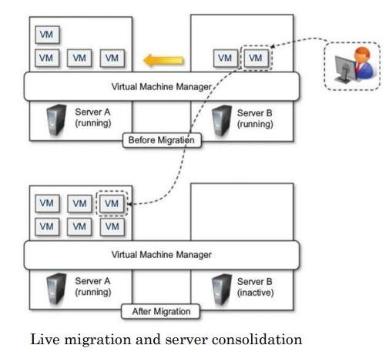
VIRTUALIZATION AND CLOUD COMPUTING

Slide 88
Difference VIRTUALIZATION AND CLOUD COMPUTING
S.NO | Cloud Computing | Virtualization
1. | Cloud computing is used to provide pools and automated resources that can be accessed on-demand. | While It is used to make various simulated environments through a physical hardware system.
2. | Cloud computing setup is tedious, complicated. | While virtualization setup is simple as compared to cloud computing.
3. | Cloud computing is high scalable. | While virtualization is low scalable compared to cloud computing.
4. | Cloud computing is Very flexible. | While virtualization is less flexible than cloud computing.
5. | In the condition of disaster recovery, cloud computing relies on multiple machines. | While it relies on single peripheral device.

Slide 89
6. | In cloud computing, the workload is stateless. | In virtualization, the workload is stateful.
7. | The total cost of cloud computing is higher than virtualization. | The total cost of virtualization is lower than Cloud Computing.
8. | Cloud computing requires many dedicated hardware. | While single dedicated hardware can do a great job in it.
9. | Cloud computing provides unlimited storage space. | While storage space depends on physical server capacity in virtualization.
10. | Cloud computing is of two types : Public cloud and Private cloud. | Virtualization is of two types : Hardware virtualization and Application virtualization.
11. | In Cloud Computing, Configuration is image based. | In Virtualization, Configuration is template based.
12. | In cloud computing, we utilize the entire server capacity and the entire servers are consolidated. | In Virtualization, the entire servers are on-demand.
13. | In cloud computing, the pricing pay as you go model, and consumption is the metric on which billing is done. | In Virtualization, the pricing is totally dependent on infrastructure costs.

Slide 90
PROS AND CONS OF VIRTUALIZATION
Advantages of virtualization
Managed execution and isolation
Avoid harmful operations
Portability, Self containment
Both contribute to reduce the costs of maintenance
Efficient use of resources
Disadvantages
Performance degradation
Inefficiency and degraded user experience
Security holes and new threats

Slide 91
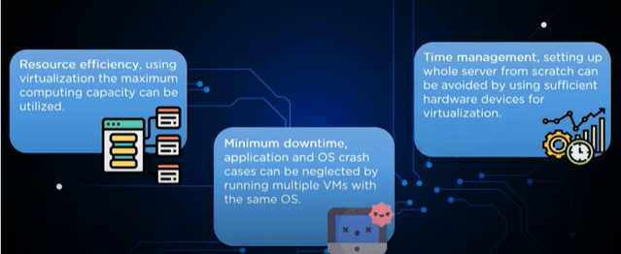
PROS AND CONS OF VIRTUALIZATION

Slide 92


